Slide 1
IBPSES
CT104-3-2-VD1
Financial Accounting
Prepared by: NKN First Prepared on: 01.01.12 Last Modified on: 01.02.18
Quality checked by: SKS
Copyright 2012 Asia Pacific University of Technology and Innovation

Slide 2
Unit Overview
FI Organizational Structure
FI Master Data
FI Processes
FI Reporting
Audit Trails

Slide 3
Goal of Financial Accounting (FI)
Financial Accounting is designed to collect the transactional data that provides a foundation for preparing the standard portfolio of reports.
In general, these reports are primarily, but not exclusively, directed at external parties.
Standard reports include:
Balance Sheet (assets, liabilities, equity)
Income Statement (net income: Revenue, Gains, Expenses and Loss)
Statement of Cash Flows

Slide 4
FI Reporting
Balance Sheet
Presentation of an organization’s Assets, Liabilities, and Equity at a point in time
Assets: What the company owns
Liabilities: What the company owes
Equity: The difference between Assets and Liabilities
Assets = Liabilities + Equity

Slide 5
FI Reporting
Balance Sheet Example
Assets
Cash 1,000
Accounts Receivable 3,000
Equipment 500
Total Assets 4,500
Liabilities
Accounts Payable 750
Taxes Payable 250
Total Liabilities 1,250
Equity
Common Stock 2,000
Retained Earnings 250
Total Equity 2,250
Total Liabilities
and Equity 4,500

Slide 6
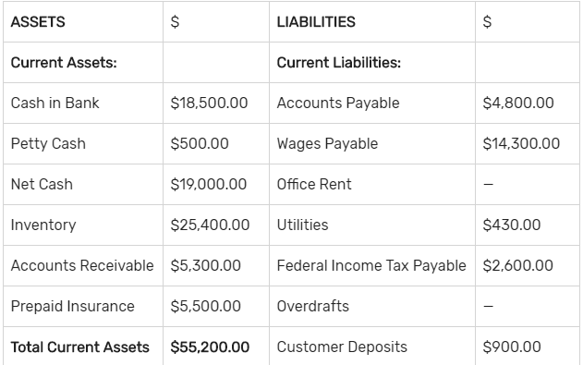

Balance Sheet (assets, liabilities, equity)

Slide 7
FI Reporting
Income Statement
Presentation of an organization’s revenues and expenses for a given period of time (e.g. monthly, quarterly, or yearly)
Revenues, in a simple sense, are inflows of cash as a result of selling activities or the disposal of company assets.
Expenses, in a simple sense, are outflows of cash or the creation of liabilities to support company operations.
Revenues - Expenses = Net Income

Slide 8
FI Reporting
Income Statement Example
Revenue
Sales 11,000
Deductions 750
Total Revenue 10,250
Operating Expenses
Cost of Goods Sold 4,500
Operating Expenses 3,750
Total Expenses 8,250
Net Income Before Taxes 2,000
Taxes 750
Net Income 1,250

Slide 9
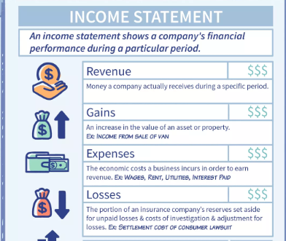
Income Statement (net income: Revenue, Gains, Expenses and Loss)

Slide 10
Target Audience
Internal
Executives
Senior Management
Administrative Staff
Employees
External
Legal Authorities
Banks
Auditors
Shareholders
Insurance
Taxing Authorities
Media
Financial Analysts

Slide 11
FI Organizational Structure
Forms a framework that supports the activities of a business in the manner desired by management
Permits the accurate and organized collection of business information
Supports the development and presentation of relevant information in order to enable and support business decisions

Slide 12
FI Organizational Structure
Assets
Liabilities &
Owners Equity
Client
An independent environment in the system
Company Code
Represents an independent legal accounting unit
Balanced set of books, as required by law, are prepared at this level.
A client may have more than one company code
United States
Germany
United Kingdom
Australia
…

Slide 13
FI Organizational Structure
Chart of Accounts
A classification scheme consisting of a group of general ledger (G/L) accounts
Provides a framework for the recording of values to ensure an orderly rendering of accounting data
The G/L accounts it contains are used by one or more company codes.
Credit Control Area
An organizational entity which grants and monitors a credit limit for customers.
It can include one or more company codes
Business Area
An organizational unit that represents a separate area of operations or responsibilities within an organization and to which value changes recorded in Financial Accounting can be allocated
Financial statements can be created for business areas, and these statements can be used for various internal reporting purposes.

Slide 14
GBI 2.0 Structure for Financial Accounting
Global Bike
Client
Global Bike Inc.
Global Bike Germany GmbH
Company
Code
Global Bike
Chart of Accounts
Chart of
Accounts
Bikes
Business Area
Global Credit Control
Credit Control
Area

Slide 15
GBI 2.0 Enterprise Structure in SAP ERP (Accounting)
Business Area – Bikes BI00
CC CA00
CC GB00
CC AU00
CC JP00
CC US00
CC DE00
Company
Code
Chart of Accounts (global) GL00
Credit Control Area (global) GL00
CA North Am. NA00
CA Europe EU00
CA Asia AS00
Controlling Area
(see Controlling unit)
Operating Concern (global) GL00
Operating Concern
(see Controlling unit)
Client GBI
Notes:
Organizational units displayed in grey are not yet implemented, but are already planned in GBI.

Slide 16
FI Master Data
General Ledger (G/L) Accounts
The unique combination of Company Code and Chart of Account creates a data storage area called a General Ledger.
Document/process used to record and summarizes company’s transaction.
The General Ledger contains a listing of the transactions effecting each account in the Chart of Accounts and the respective account balance.
It is utilized in the preparation of financial accounting statements.

Slide 17
FI Master Data
Customer and Vendor Master Data
Customer and vendor account balances are maintained in FI through fully integrated accounts receivable and accounts payable sub-modules.
Financial postings for customers and vendors are made directly to their respective individual accounts and accompanied by a concurrent automatic posting to the General Ledger.

Slide 18
Customer Accounts
Accounts Receivable Sub-Module (FI-AR)
Information with respect to customers who purchase the enterprise’s goods and services such as sales and payments made
Substantive and important integration between Sales and Distribution (SD) and Financial Accounting (FI)
Billings in SD generate FI journal entries for sales activity
Customer 189
Customer 142
Accounts Receivable
(General Ledger)
100
300
950
Customer 135
Customer 123
400
150

Slide 19
Vendor Accounts
Accounts Payable Sub-Module (FI-AP)
Information with respect to Vendors from whom the enterprise purchases goods and services such as purchases and payments made
Substantive and important integration between Materials Management (MM) and Financial Accounting (FI)
Purchase and goods receipt activities in MM generate FI journal entries
Vendor 100234
Vendor 100435
Accounts Payable
(General Ledger)
200
250
850
Vendor 100621
Vendor 100846
100
300

Slide 20
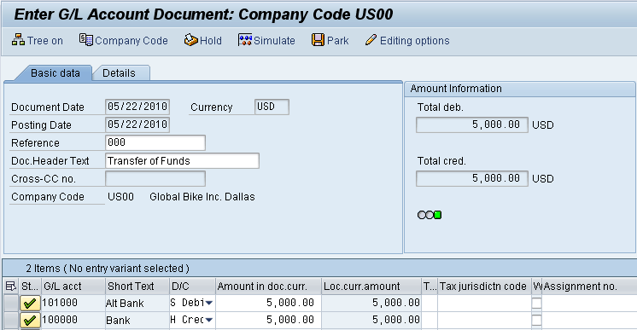
FI Processes
Posting a G/L Entry

Slide 21
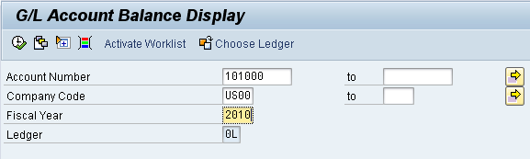
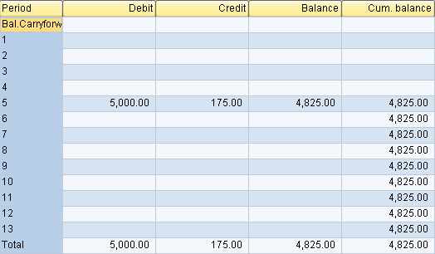
FI Reporting
G/L Account Summary

Slide 22
Tutorial
Learning Objective: Understand and perform a financial accounting process
Scenario:
GBI has rented a new building (warehouse) from a new landlord, Cardinal properties.
You are required to create a new master data for accounts payable process to pay the rental fee for a new landlord. The invoice received from Cardinal Properties for this month’s rent of $1,500.00.
In order to process a complete accounts payables process within financial accounting, you will take on different roles within GBI company. You will be working in the Finance Account Department.
Before you can post the account payables invoice, master data has to be maintained. Within the case study, you will create necessary accounts within the General ledger and create the vendor. Afterwards you will post the invoice and verify the changes on your accounts.

Slide 23
Steps
Create Bank Account in General Account- Pay rental Fee
Create Reconciliation Account in GL- Used to connect GL that are maintained for customers, Vendors, materials and etc. Will be assigned assign to a new vendor.
Create Expense Account in General Ledger
Create Vendor Master Record for Landlord
Post Transfer of Funds to Alternate Bank Account
Create Invoice Receipt for Rent Expense
Post Payment to Landlord
Display and Review General Ledger Account Balances and Individual Line Items
Display and Review Accounts Payable Balances and Individual Line Items

Slide 24
CREATE BANK ACCOUNT IN GENERAL LEDGER
The general ledger is a core component of an accounting system.
General Ledger in SAP ERP:
Data from a range of process modules are incorporated into a
single database.
Generate financial statements and informational reports, manage a business’s cash flow and fixed asset accounts, as well as perform accounts payable and accounts receivable transactions.

Slide 25
Create Bank Account in General Account: Pay rental Fee FS00
Create a new alternate Bank Account : (Copy from existing bank account 100000)
Bank Account: 10###5
Short Text: Bank ###
Long Text: Bank Account ###

Slide 26
Create Reconciliation Account in GL- FS00
Create a reconciliation account for vendor: (Copy from existing reconciliation account 300000)
Bank Account: 11###5
Short Text: Payables-Misc ###
Long Text: Payable Miscellaneous###

Slide 27
Create Expense Account in General Ledger FS00
Create expense account for vendor: (Copy from existing expense account 740300)
Bank Account: 75###5
Short Text: Rent Expense ###
Long Text: Rent Expense ###

Slide 28
Create Vendor Master Record for Landlord FK01
Title | Cardinal Properties ###
Search term | ###
Address | Pioneer Trail
Postal Code | 55347
Postal Code | Eden Prairie
Country | US
Region | MN
Language | English
Company Code | US00
Recon. Acc | 11###5
Pay Terms | 0001
Select Check Double Invoice

Slide 29
Post Transfer of Funds to Alternate Bank Account (FB50)
To generate a journal entry for US company to transfer from current bank to alternate bank account
Doc Header text: Transfer of Funds
Bank Account: 10###5
D/C: Debit
Amount: 5000
Bank Account: 100000
D/C: Credit
Amount: 5000
Simulate> Post

Slide 30
Display G/L account document you have just created (FB03)
Click at Display Document header
Bank Account: 10###5
D/C: Debit
Amount: 5000
Bank Account: 100000
D/C: Credit
Amount: 5000

Slide 31
Create Invoice Receipt for Rent Expense (FB60)
Enter invoice received from Cardinal Properties for this month’s rent of $1,500. This invoice will be posted to an existing G/L expense account in your chart of accounts and saves as an Accounts Payable
Vendor Number | Search your vendor number
Amount | 1500
Company Code | US00
Text | Invoice Cardinal Rent Expenses-###
Cost Center | NAHR2###

Slide 32
Post Payment to Landlord (F-53)
Issue a payment to Cardinal Properties to settle the Accounts Payable for this month’s rent. A journal entry is made to Accounts Payable for Cardinal Properties and to the bank checking account in the G/L
Bank Account | 10###5
Amount | 1500
Text | Invoice HR-###
Account | Enter Vendor Number

Slide 33
FI Reporting
Statement of Cash Flows
Considers the associated changes, both inflows and outflows, that have occurred in cash – arguably the most important of all assets – over a given period of time (e.g. monthly, quarterly, or annually)

Slide 34
Accountants and Audit Trails
Audit trails allow an auditor to begin with an account balance on a financial statement and trace through the accounting records to the transactions that support the account balance.
Audit trails enable an auditor to trace individual transactions to the effected account balance(s) on a financial statement.

Slide 35
SAP Document Principle
Each business transaction impacting FI writes data to the SAP database creating a uniquely numbered electronic document.
The document number can be used to recall the transaction at a later date.
It contains, for example, such critical and necessary information as:
Responsible person
Date and time of the transaction
Commercial content
Once written to the SAP database, a financial document (one impacting the financial position of the company) can not be deleted from the database.
It can be changed to some degree.
The SAP document principle provides a solid and important framework for a strong internal control system – a requirement of law for companies that operate in the United States and in most other countries in the world.

Slide 36
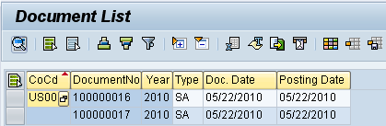
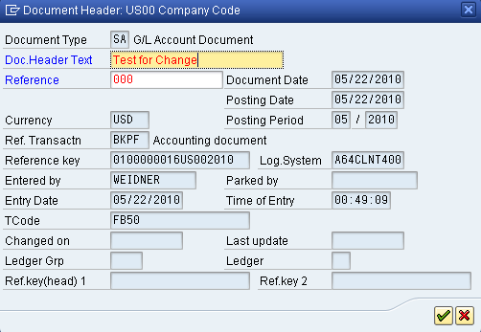
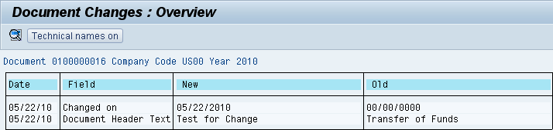
SAP Document Principle

Slide 37
SAP FI Module
Fully integrated with other SAP modules including, but not limited to:
Sales and Distribution (SD)
Materials Management (MM)
Production Planning and Execution (PP)
Managerial Accounting (CO)

Slide 38
Question and Answer Session
Q & A

Slide 39
What we will cover next
Management Accounting

